Slide 1
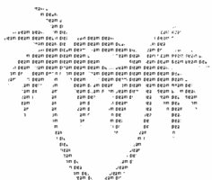
Developerparadise
Mohammad
RJ Lusk
Deytia Lima

Slide 2
influence?

Slide 3
Agenda
Objective
Data and assumptions
Approach
Results

Slide 4
OBJECTIVE
Determine the level of influence of a repository

Slide 5
Data
Variables
"nW" "nFr" "nPu" "nDe" "nAu" "nFi" "Siz" "nFl“ "nFd" "t_diff“
Preparing and Cleaning Data set
-Variable rates (Var/Day)
-Variables scaled
-Log(variables)
-Training Set(2008-2013)
-Full Set
-t_diff>0

Slide 6
APPROACH
PCA (Variable Selection)
Factor Analysis (Influence Metrics)
Clustering

Slide 7
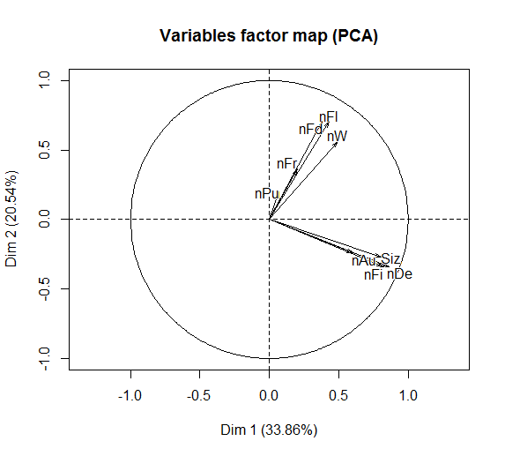
PCA
First Component (34%)
-NDe,Siz,nFi (correlated
-nAu
Second Component (21%)
-nFl,nFd,nW
Third Component (13%)
-nFr
-nPu

Slide 8
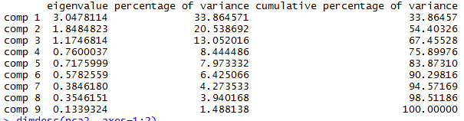
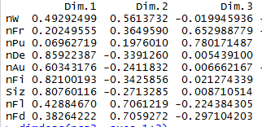
INFLUENCE
Infl= (0.34/0.68)*(0.86*p2trains$nDe+0.6*p2trains$nAu)
+(0.21/0.68)*(0.7*p2trains$nFl)
+(0.13/0.68)*(0.65*p2trains$nFr+0.78*p2trains$nPu)
Eigen Values
Eigen Vectors

Slide 9
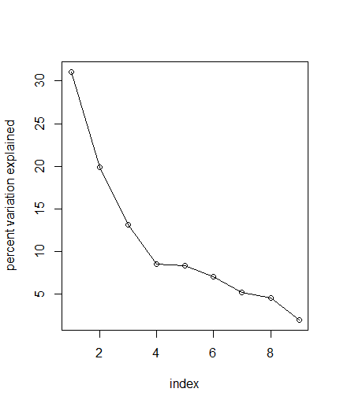
SCREE PLOT

Slide 10
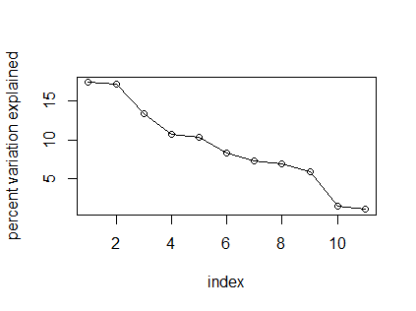
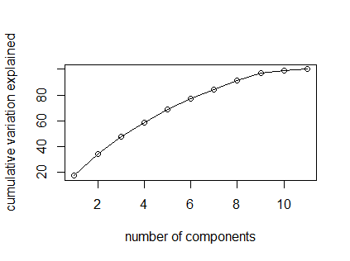
SCRE PLOTS PCA Actual variables

Slide 11
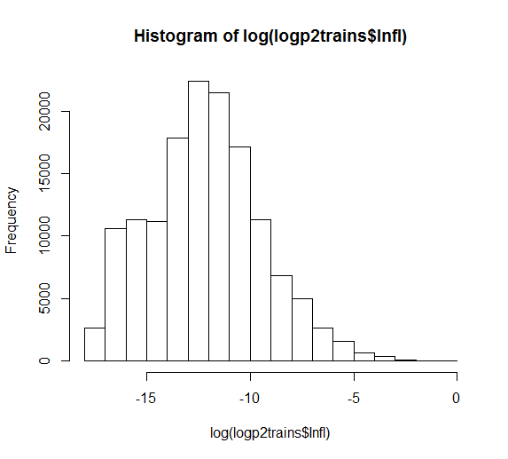
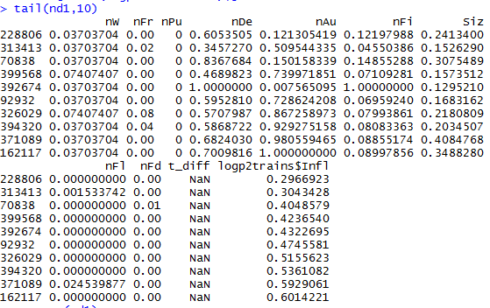
INFLUENCE traindata
Influence Distribution

Slide 12
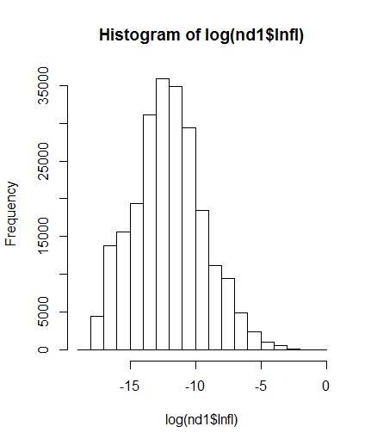
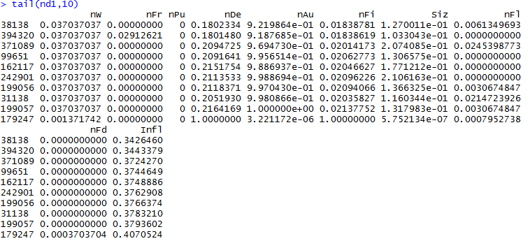
INFLUENCE all data
Influence Distribution

Slide 13
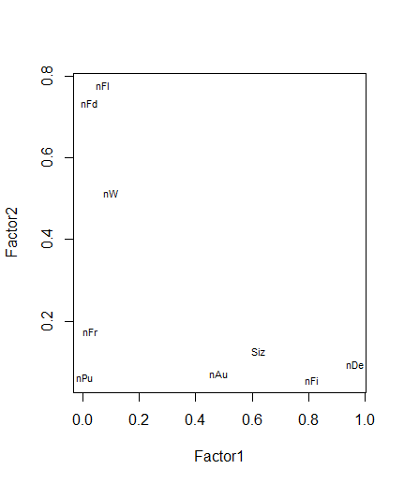
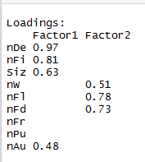
FACTOR ANALYSIS
Factor1
nAu,nDe,Siz and nFi
Define number of interventions
Coded actually changed
Factor2
nFr,nFl,nFd
Define Popularity

Slide 14
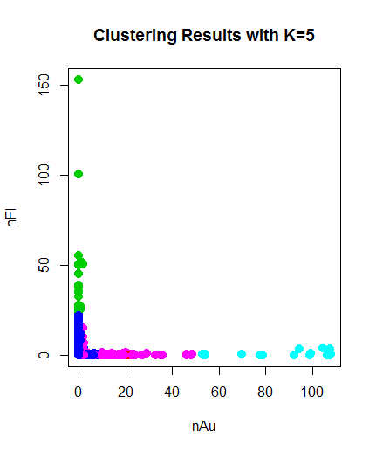
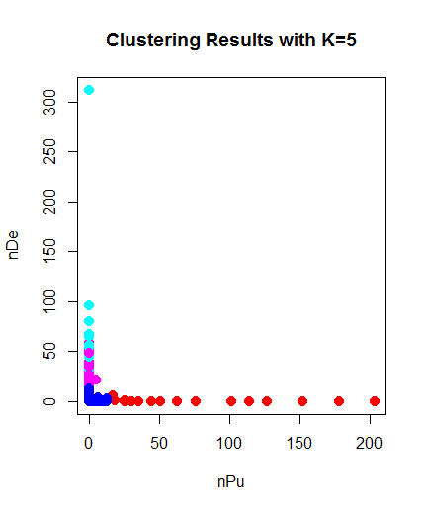
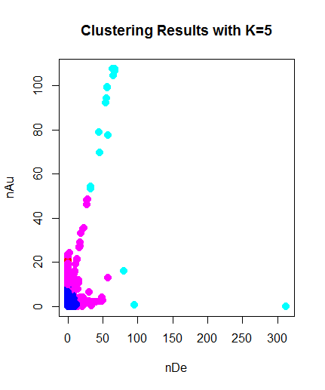
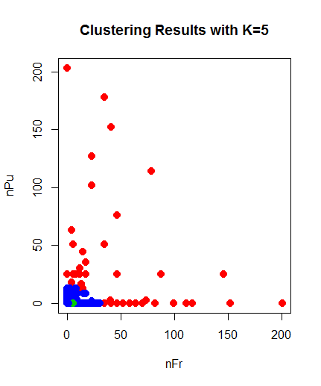

CLUSTERING ANALYSIS
#red,green,blue,cyan,magenta

Slide 15

Questions?

Slide 16
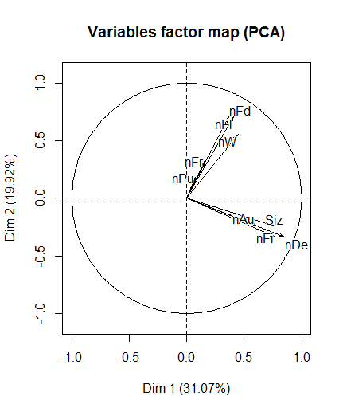
PCA-FULL SET
First Component (31%)
-NDe,Siz,nFi (correlated
-nAu
Second Component (20%)
-nFl,nFd,nW
Third Component (13%)
-nFr
-nPu

Slide 17
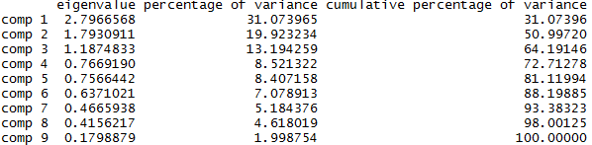
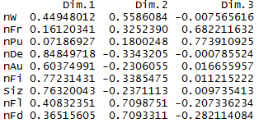
EIGEN VECTORS FULL SET
Eigen Values
Eigen Vectors

Slide 18
SCRE PLOT FULL SET

